Slide 1
Bookworms
By Wendy Haw and Noorulain Irshad

Slide 2
System Description
Simple book-rating web application
Users rate and comment on books
Users can create lists of books

Slide 3
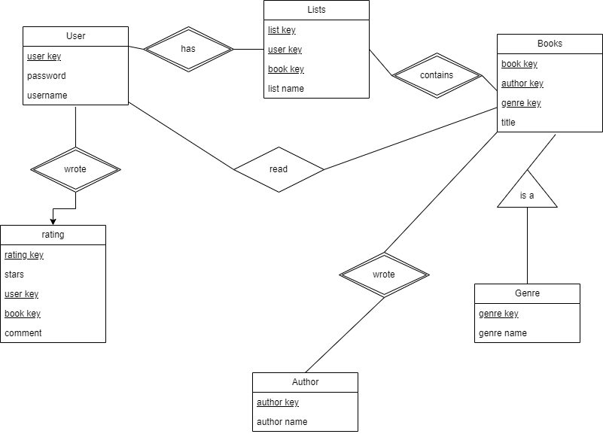
E/R Diagram

Slide 4
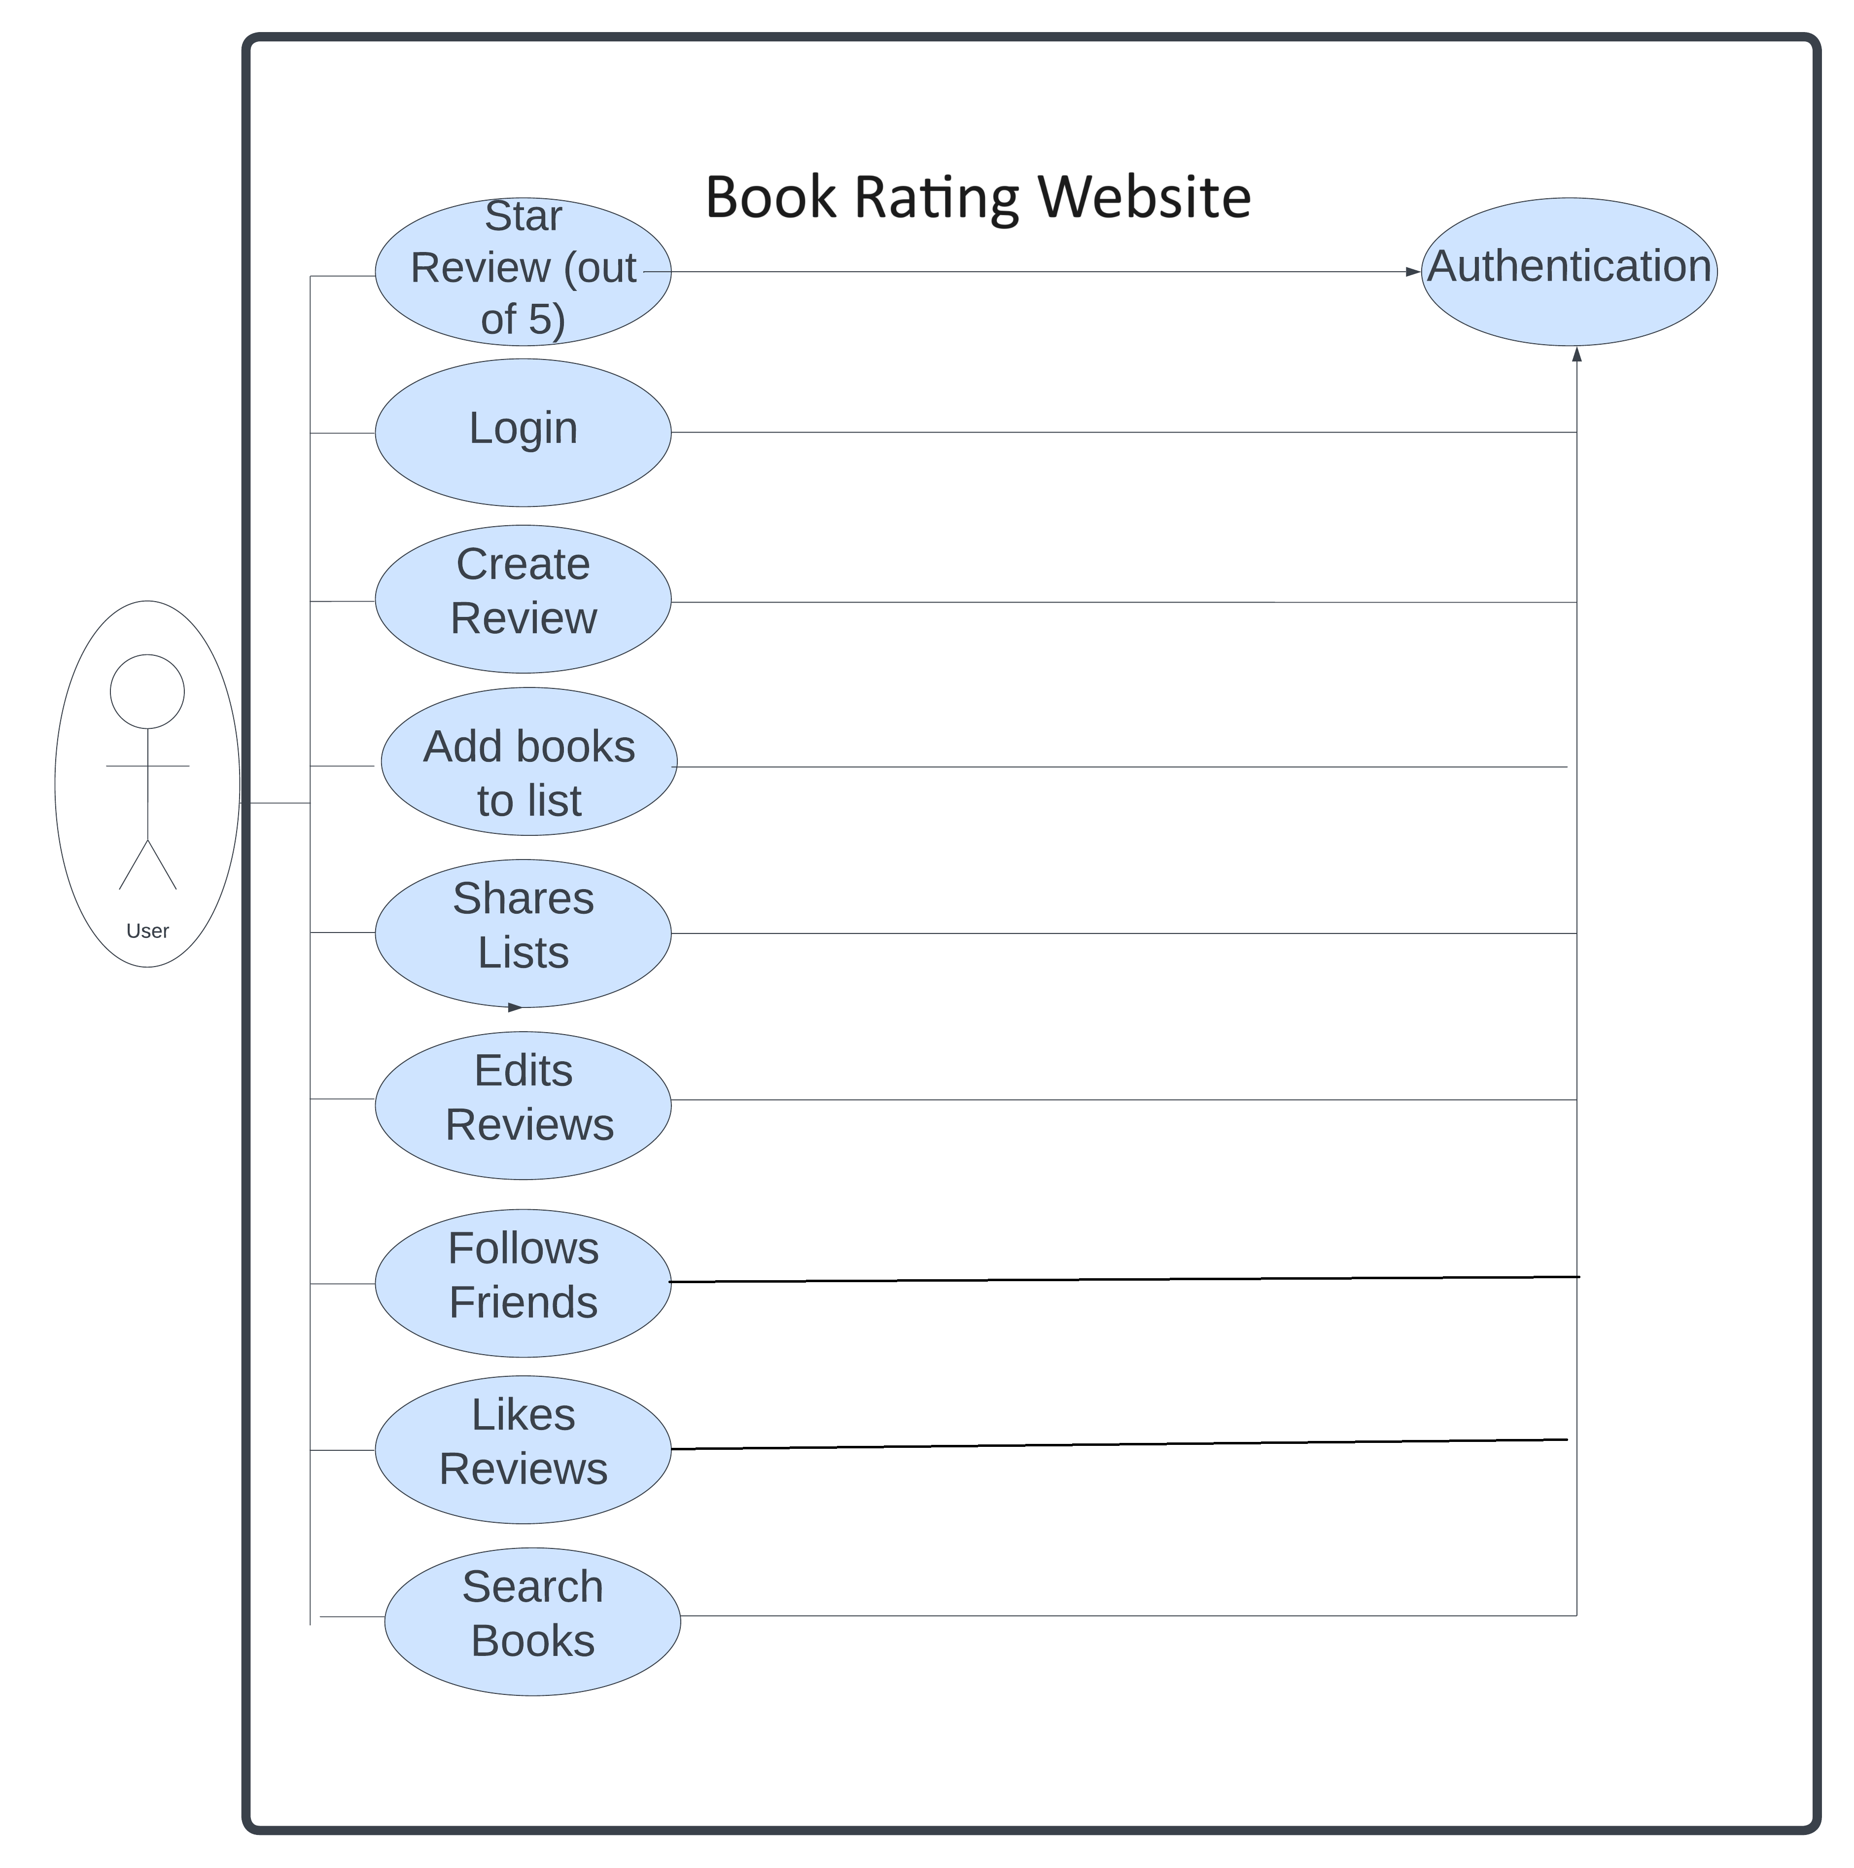
UML Diagram

